Slide 1
He neutrinos emission from sn explosion
Weekly Analysis Meeting – 29/05/25
V. Oliviero, I. Rea, M. Bendahman, W. Idrissi Ibnsalih

Slide 2
Status of the analysis
Cut&Count Analysis:
Moved to Aanet 2.6 (no bug) -> the results changed little (1-2%)
Done for both IIn and IIP SN model;
Done with ARCA8,ARCA19 and ARCA21 configuration;
Catalog -> on going analysis with the sources for all the configuration + combined configuration;
Next step: Optimization of cone & LogEtreshold parameters.
Unbinned Time dependent:
Done tests with the box function;
Next step: to implement the light curve from Murase in the code.

Slide 3
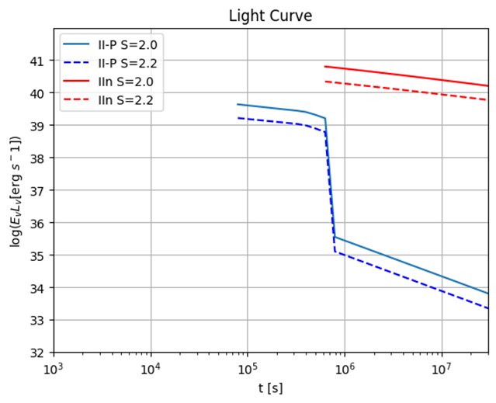
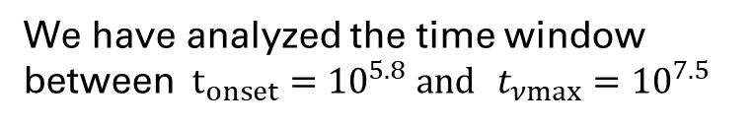

MODELING THE FLUX – SN IIN
We studied first SN IIn emission model, with s=2.0.
We have analyzed the time window between$t_{onset}={10}^{5.8} and t_{νmax}{={10}^{7.5}}$
$$t_{νmax}{−t_{onset}=358,7 days∼1 years}$$

Slide 4
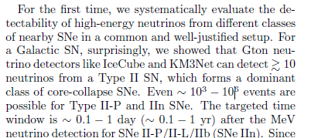
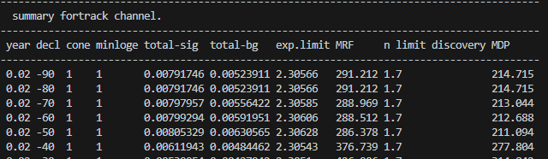
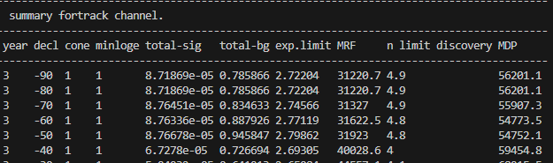


Modeling the flux – sn iIp
First period IIP – time window ≈ 6 days
Second period IIP – time window ≈ 3 years

Slide 5
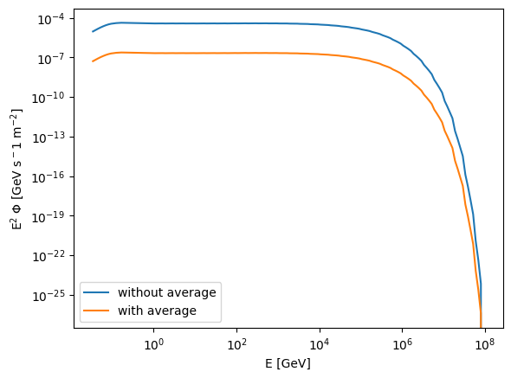
Modeling the flux – sn iIp

Slide 6
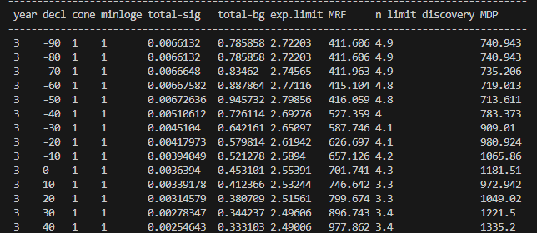
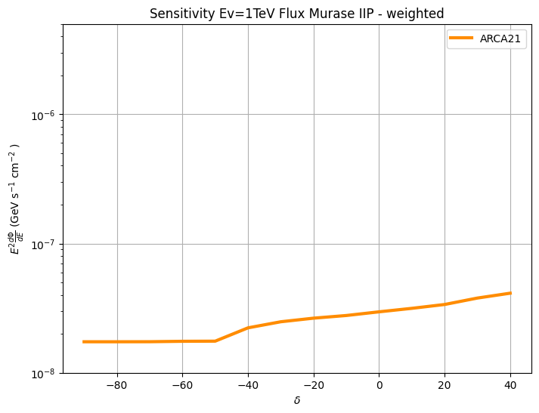
Modeling the flux – sn iIp
d = 1Mpc
3 yrs
Preliminary results
We choose to use the average flux over 3 years -> Results similar to the one of the time window suggested by Murase
The results for the IIP will significantly improve with the Unbinned Time dependent Likelihood!

Slide 7
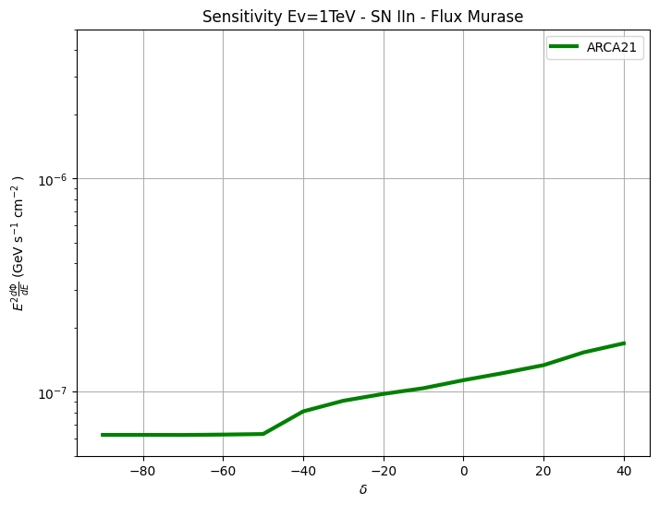

Cut&count analysis - 1
d = 1Mpc
1 yr
d = 1Mpc
3 yrs
Preliminary results
Preliminary results

Slide 8
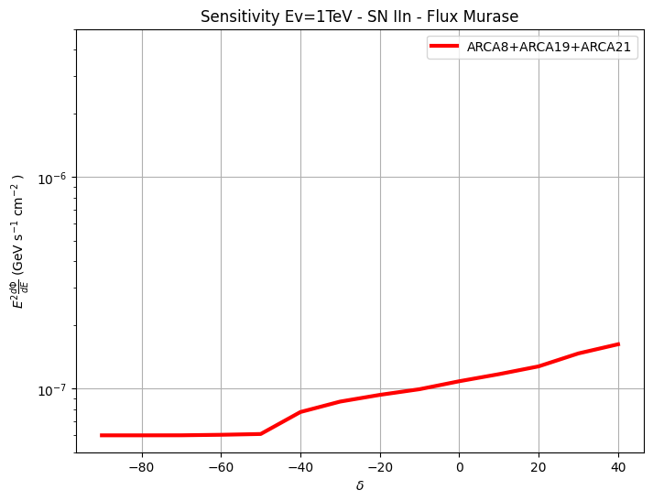
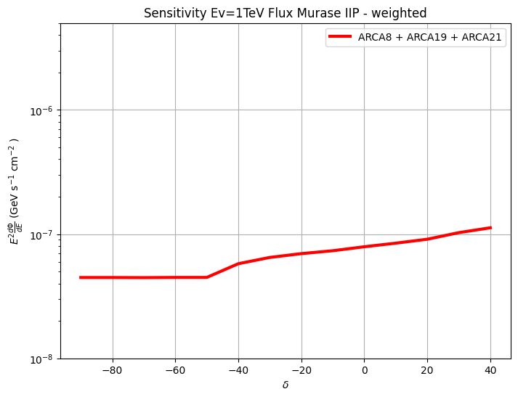
Cut&count analysis - 2
d = 1Mpc
Life time of det configurations
d = 1Mpc
Life time of det configurations
Preliminary results
Preliminary results

Slide 9
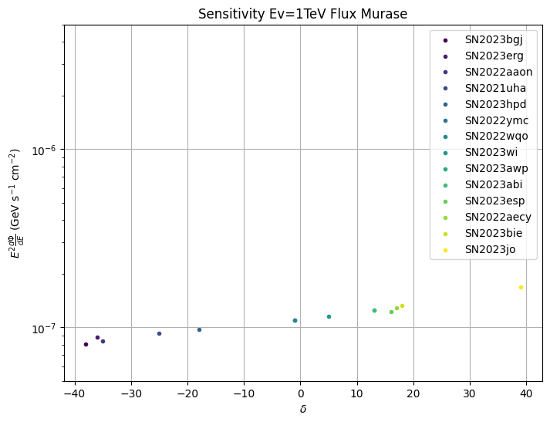
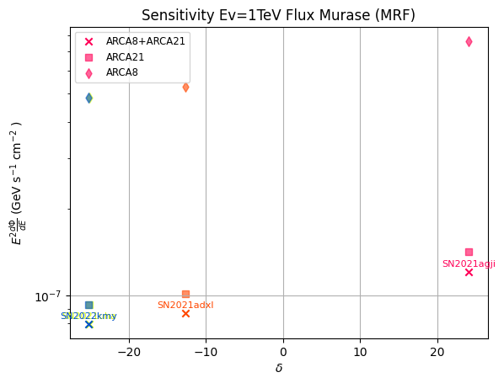
Catalog – SN iin
There is an overlap between different configuration for some sources
ARCA 21
Preliminary results
Preliminary results

Slide 10
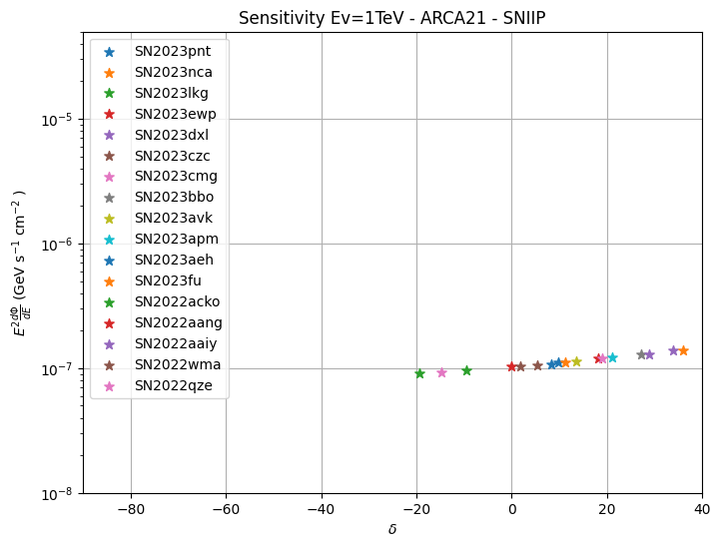
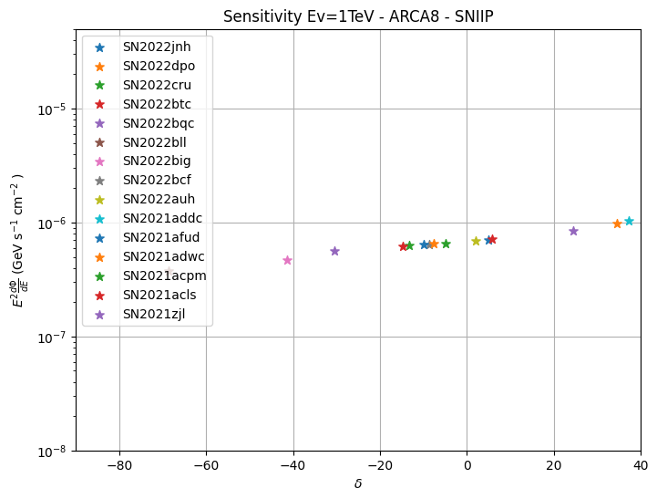
Catalog – SN iIp
ARCA 21
ARCA 8
Preliminary results
Preliminary results

Slide 11
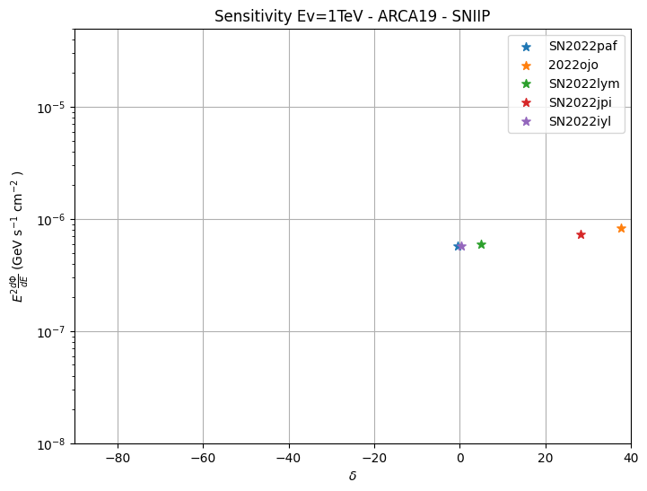
Catalog – SN iIp
ARCA 19
Preliminary results

Slide 12
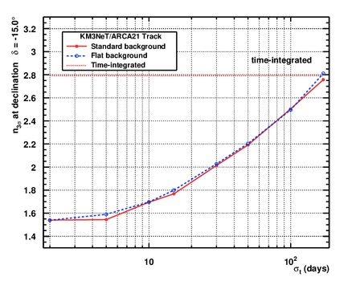

Unbinned - time depedent
Discovery Potential from tests on box function (Thanks to Walid, Francesco C., Meriem and Sonia)
As next step, I will help to implement the light curve of Murase in the framework.

